Slide 1
Interconnecting Devices

Slide 2
Session Objectives
After going through this session you will be able to understand:
Networking
The devices used in Networking like Router, Switch, Hub, Bridges and Repeaters
The network layer at which they operate
Working of each device

Slide 3
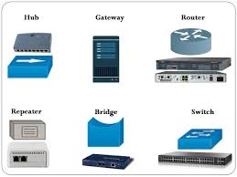
Introduction
Network is an infrastructure made up of interconnecting devices.
The most common devices are Hub, Switch, Router and Bridge.
The devices are used to create LAN, WAN and MAN networks.
The device make communication possible from one end to another.
Each device follows a set of rule for data communication.
The device does the job of signal enhancement, forwarding and routing.

Slide 4
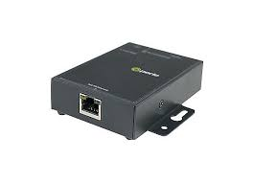
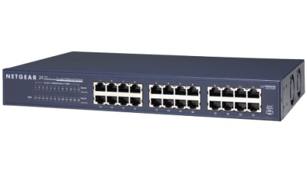
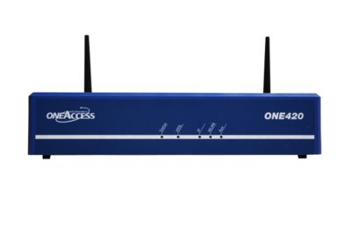
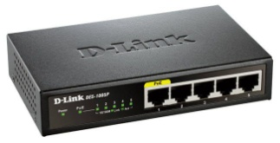
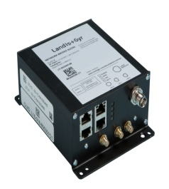
List of Networking Devices
  Repeaters Switches
  Hubs Routers
  Bridges

Slide 5

Layer Based Working of Connecting Devices

Slide 6
Repeaters
A physical layer device that acts on bits not on frames or packets.
Can have two or more interfaces.
When a bit (0,1) arrives, the repeater receives it and regenerates it, and transmits it onto all other interfaces.
Used in LAN to connect cable segments and extend the maximum cable length.
  Ethernet 10base5 – Max. segment length 500m – 4 repeaters (5 segments) are used to extend the cable to 2500m)
  Ethernet 10Base2- Max. segment length 185m - 4 repeaters (5 segments) are used to extend the cable to 925m
Repeaters do not implement any access method that means if any two nodes on any two connected segments transmit at the same time collision will happen.
Contd…

Slide 7

Figure 1: Function of a Repeater
Contd…

Slide 8

Figure 2: A repeater connecting two segments of a LAN

Slide 9
Hubs
Works on the physical layer and is also called multiport repeater.
Operate on bits rather than frames.
Used to connect stations adapters in a physical star topology but logically bus.
Connection to the hub consists of two pairs of twisted pair wire one for transmission and the other for receiving.
Follows no access method in data transmission.
Does not do filtering it just copy the received frame onto all other links
The entire hub forms a single collision domain, and a single Broadcast domain
  Collision domain: is that part of the network (set of NICs) when two or more nodes transmit at the same time collision will happen.
  Broadcast domain: is that part of the network (set of NIC) where each NIC can 'see' other NICs' traffic broadcast messages.
Multiple Hubs can be used to extend the network length.
  No buffering at the hub.
Contd…

Slide 10
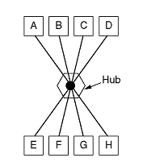
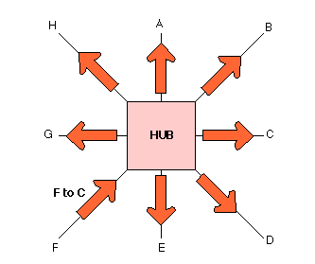

Figure 3: Hub Interconnection

Slide 11
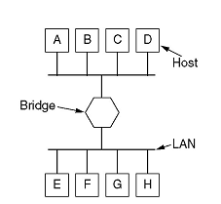
Bridges
Acts on the data link layer (MAC address level).
Used to divide (segment) the LAN into smaller LANs segments, or to connect LANs that use identical physical and data link layers protocol.
Each LAN segment is a separate collision domain.
Bridge does not send the received frame to all other interfaces like hubs and repeaters, but it performs filtering .
Bridge uses a bridge table (forwarding table) that contains entries for the nodes on the LAN for packet forwarding.
A bridge runs CSMA/CD before sending a frame onto the link not like the hub or repeater.
Contd…

Slide 12

Figure 4: A bridge connecting two LANs
Contd…

Slide 13

Figure 5: A learning bridge and the process of learning

Slide 14
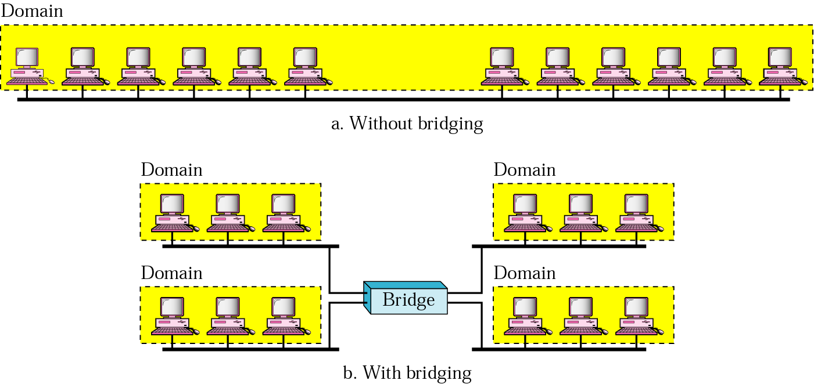
Figure 6: A learning bridge and the process of learning
(a) In heavy load, each station has an average effective theoretical bandwidth = 10/12
(b) Each station has an average effective bandwidth equal =10/3
Contd…

Slide 15
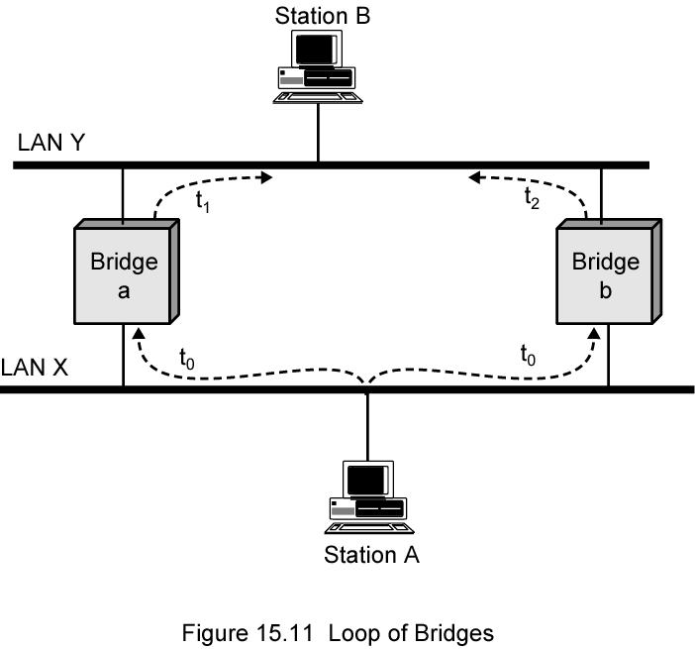
Figure 7: Looping problem-1 in Bridge connectivity
Contd…

Slide 16
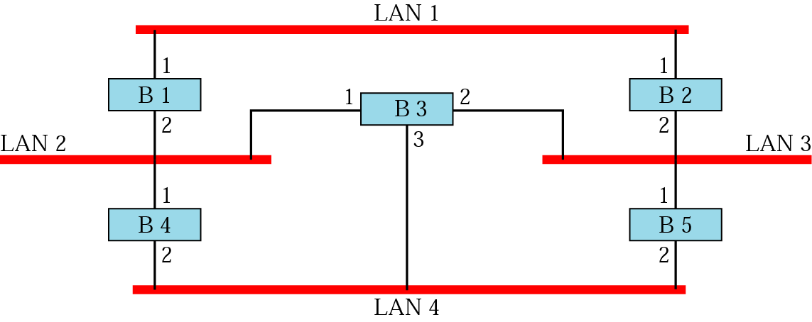
Figure 8: Looping problem-2 in Bridge connectivity
When using switches, the network should not contain any loop (there should be exactly one path from any LAN to any other LAN
Loops can cause number of frames in the LAN to increase indefinitely
Contd…

Slide 17
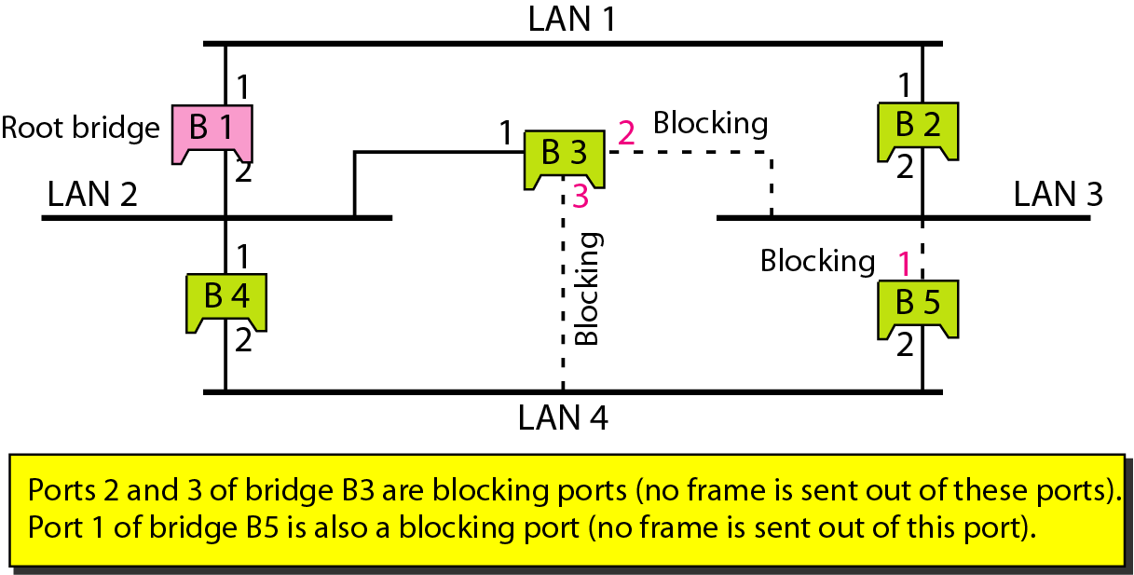
Figure 9: Looping problem Solution
Loops are logically disabled by the minimum spanning tree algorithm

Slide 18
Switch
N-Port bridge where N is equal to number of stations
Usually used to connect individual computers not LANs like bridge
Allows more than one device connected to the switch directly to transmit simultaneously
Can operates in Full-duplex mode.
Performs MAC address recognition and frame forwarding in hardware (bridge in software)
Two types :
    Store-and-forward: switch receives the whole frame on the input line, buffers it, briefly performs error checking, then routes it to the appropriate output line (similar to bridge).
    Cut-through: based on the destination address the frame is directly sent to the appropriate output line without buffering. Here no error checking is performed
Contd…

Slide 19
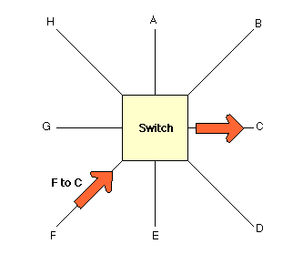
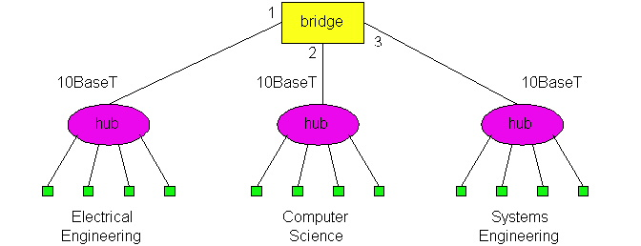
Figure 10: Switch Interconnection -1
A Hub sending a packet form F to C.
A Switch sending a packet from F to C
Switch
Contd…

Slide 20
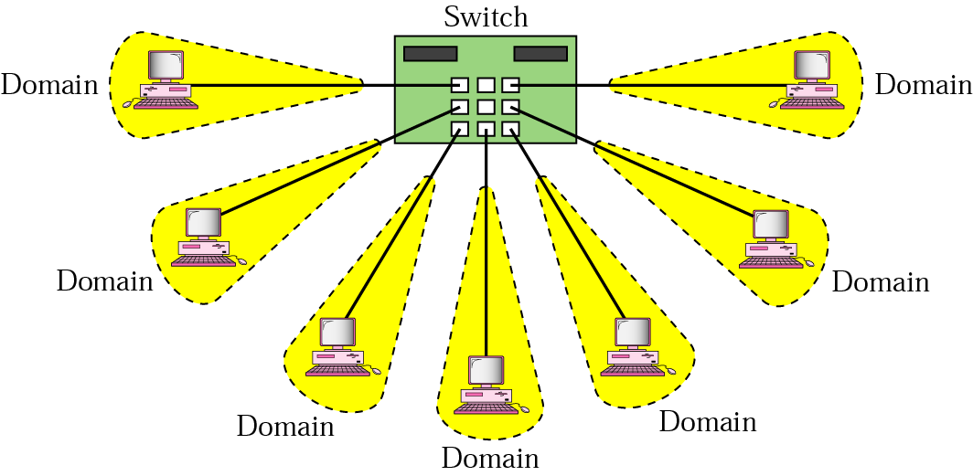
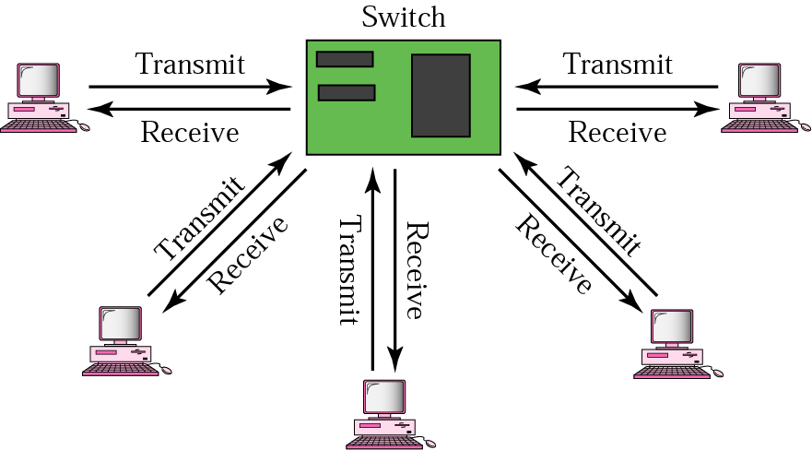
Figure 11: Switch Interconnection -2
Isolated collision domains
Full-Duplex operation

Slide 21
Router
  Operates at network layer and deals with packets not frames.
  Connect LANs and WANs with similar or different protocols together.
  Routers isolate both collision domains and broadcast domains
  Acts like normal stations on a network, but have more than one network address (an address to each connected network).
  Deals with global address ( network layer address (IP)) not local address (MAC address).
  Routers Communicate with each other and exchange routing information.
  Determine best route using routing algorithm by special software installed on them.
  Forward traffic if information on destination is available otherwise discard it (not like a switch or bridge).
Contd…

Slide 22

Figure 12: Routers connecting independent LANs and WANs
Routers

Slide 23
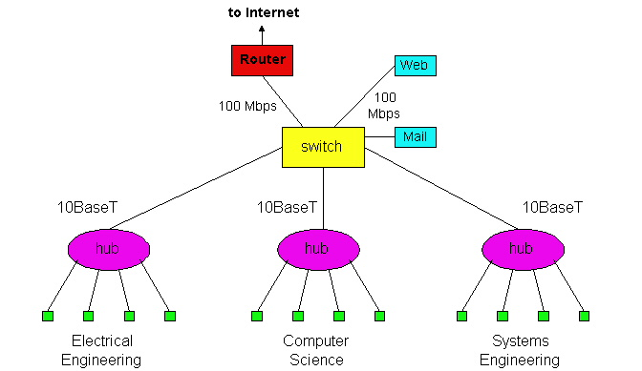
Figure 13: Interconnecting Router, Switch and Hubs

Slide 24
Summary
In this section we have discussed the following:
Interconnecting Devices
Looping in LAN and eliminating it using Spanning Tree Protocol
Broadcast and Collision Domains
Notes:
1.#

Slide 25

Notes:
1.#

